Slide 1
Career Cluster Title Your name Today’s Date
Your first slide is always your Title slide

Slide 2
The Job title you chose to research
Job Description
This slide should tell me a something about the job you have chose to research. A picture would be nice. 10 points for a description 10 points for a picture

Slide 3
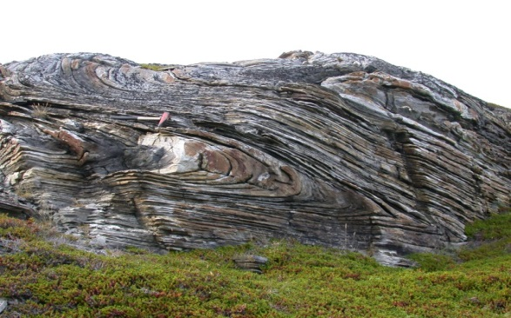
Skills Required: 15 points for telling us what skills are required for this job you have chosen to research Is this a physical job? Do you need creative skills? Writing skills? Negotiation skills? Will you need public speaking skills? The ability to sing, play and instrument or dance?

Slide 4
Education Required:
15 points for telling us what kind of education is required
High school diploma?
College degree?
Advanced degree?
Specialized certifications?
Work experience?
Salary Range
15 points for telling us how much does this job pay?
The average income.
The entry level pay. (Usually the least you will earn.)
How much do the most skilled make in this job?

Slide 5
Working Conditions
10 points for telling us what kind of conditions this job would work in.
Indoors
Outdoors
In an office
In a cubicle
Where do you do this job yo have chose to research?
Career outlook :
10 points for telling us what kind of job prospects there are for this position in the future.
Is it in a growth industry?
Will there be more of less opportunity in the future?
Am I paying for an education to do a job that will not be around when I graduate?

Slide 6
Rubric 10 points for description 10 points for picture 15 points for salary range 15 points for education needed 15 points for skills required 10 points for working conditions 10 points for career outlook 15 References

Slide 7
www.texascaresonline.com www.bls.gov All the web sites where you gathered your information or pictures. This page is worth 15 points!
Your last slide will always list the web sites you found your information.

