Slide 1
Exploring Careers
Mr. Percevecz
“Mr. P”
Room 405

Slide 2

Do you have any rules at your house?

Slide 3

Rule #1.
Backpacks go on the table by the door on your way into class.

Slide 4

Rule #2. No food or drinks in class. (gum or candy)

Slide 5

Rule #3
No Bullies allowed!

Slide 6
Rule #4 No phones iPods or other electronic devices in class.
If I see it I will take it from you.

Slide 7
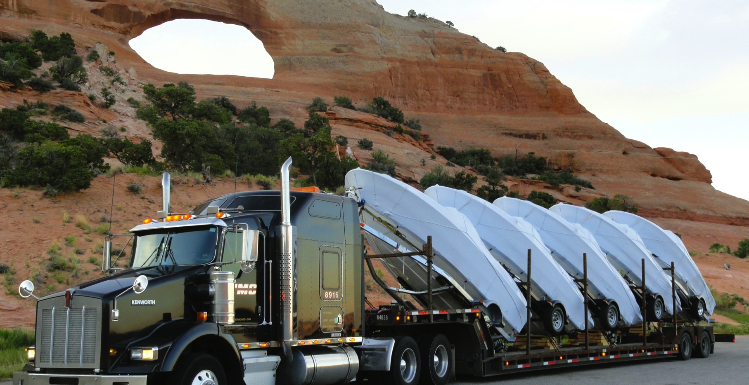
Any Questions?

Slide 8
What is Exploring Careers all about?

Slide 9
Life is all about choices. In this class we are going to look at how we make choices and we will learn how to make better choices.

